Slide 1

Our Future Music
Leader Intern
JUNE 2019
Notes:
BHMA commissioned a project manager to work alongside the Learning and Partnerships Manager to develop a toolkit as the first stage in supporting BHMA to establish a methodology, plan and supporting documents to enable the team to trail a series of paid internships over the next two years of the Our Future Music programme.

Slide 2
WHY AN OUR FUTURE MUSIC LEADER INTERN?
Valued
Understanding impact
Inclusive
Leaders and participants
Relevant
Different voices
Notes:
A sustainable music service is:
Valued by people who use it
Inclusive – welcoming people from all the communities its serves
Relevant to the people engaging with it
Inclusive music practice = inclusive recruitment
(open up new routes to employment, understanding the barriers)
Music delivery relevant to diverse participants
(background, interests and routes in, understanding)
Enriching the service
(skills, influences, networks)
valued

Slide 3

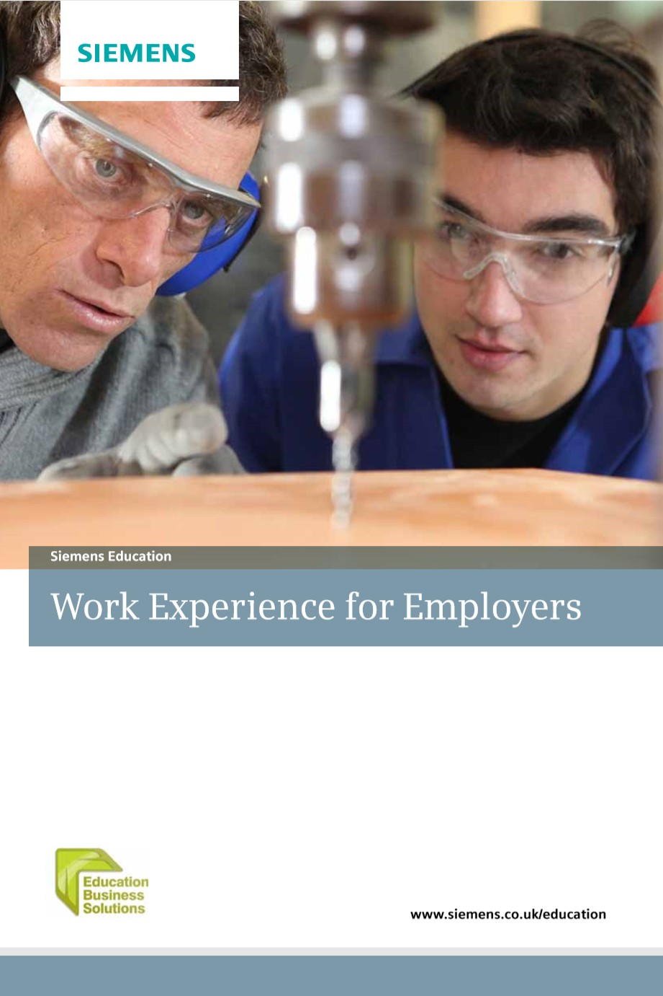
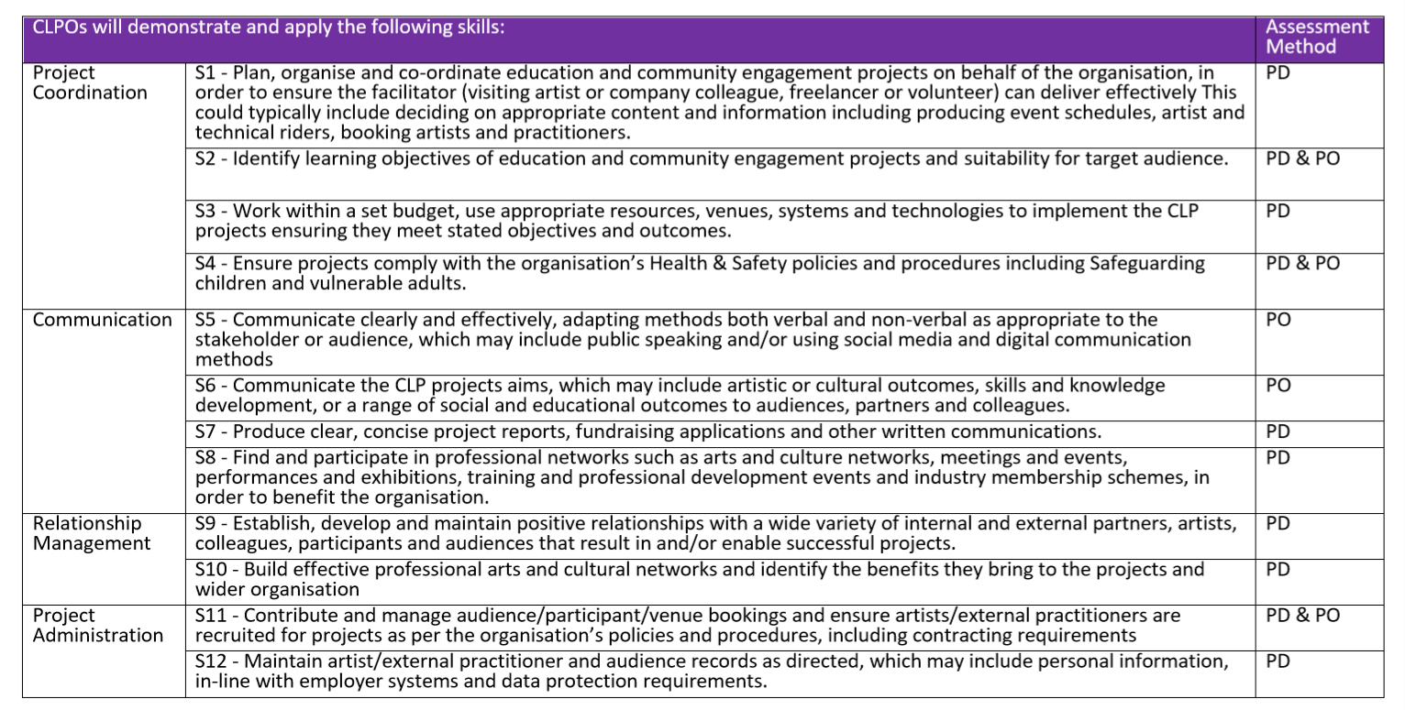
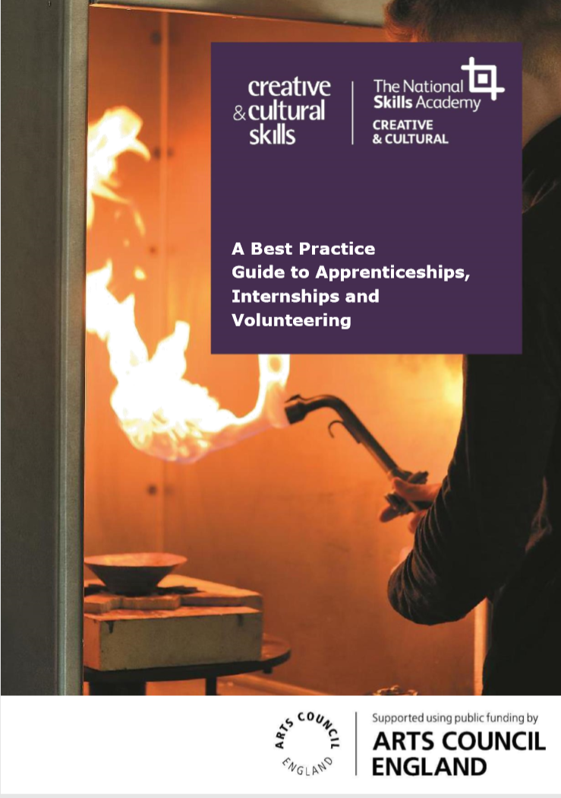







APPROACH
What are other people doing?
What do other frameworks look like?
What are some of the barriers to success?
Notes:
The first stage was to identify and collate best practice, including identifying other organisations who had begun developing similar programmes. BHMA conducted interviews with local colleges and work experience providers, the British Library, Youth Music, Creative and Cultural Skills, as well as other members of the Our Future City network.
Desk-based research in to existing resources in cultural and other sectors, including reviewing apprenticeship frameworks and more general employability skills, developed understanding and templates for activity.

Slide 4
WHAT ARE OUR GUIDING PRINCIPLES?
Open application and interview process
Symbiotic relationship between the intern and BHMA
More people involved in inducting and supporting the intern
Formalised progression structure
Range of resources and templates to draw on
The intern is better able to compete in the industry following the placement
Notes:
Initial research highlighted that work experience means different things to different people. It was necessary early on to really explore and define what that meant within the context BHMA. There was fewer resources for or definitions of internships than other types of work experience. Setting out the aims and role of the intern enabled us to develop a strong core to the programme, from which everything else derived.
A strategic approach to training and professional development for both the present and future workforce, supporting music leaders to develop more inclusive approaches.
Providing a joined-up experience for someone entering the organisation to thrive, ensuring its a safe and supportive place to learn.
Understanding the contribution the young person’s insight and experience can bring to the organisation giving to them and looking for opportunities for the Music Hub being more inclusive as a result of intern’s perspective.
Providing a structured and worthwhile work experience, with a variety of opportunities to develop and learn new skills, gain transferable skills and knowledge.

Slide 5
WHERE WILL THE INTERN START?
How it will be advertised
Interview process
Selection and monitoring

Slide 6
WHAT WILL THE INTERN DO?
Music session delivery
Managing and supporting projects
Working with young people
Collaborating with partners
Communicating with a range of audiences, including via phone, email, blogs and social media

Slide 7
WHERE WILL THE INTERN GET TO?
Develop evidence of work skills and experience
Sample different aspects of supporting music projects, such as marketing and music technology
Tailor aspects of the role and duties towards their individual skillset, experience and or interests
They will be both an active part of the project delivery and influence the way that BHMA provides future opportunities to young people across the city.

Slide 8
HOW?
1. Observation and information
4. Take responsibility
2. Supported application of learning
3. Take a lead

Slide 9
TOOLKIT CONTENTS
Research
BHMA existing stuff
Reference
Resources to support organisations
Resources
Recruitment
Induction
Activities
Performance management

Slide 10
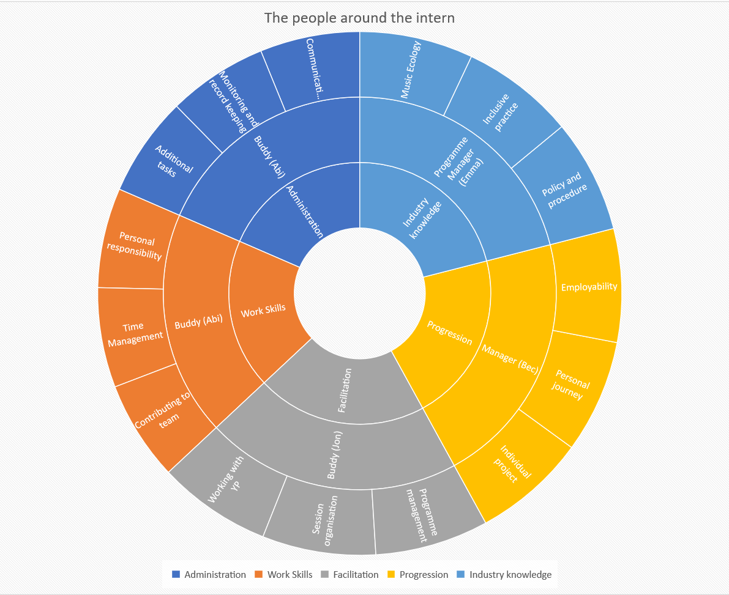
Notes:
It became clear that to get the most out of the internship for the organisation and the intern, it was important that this support was shared across the whole organisation through defining clear roles, responsibilities and lines of communication and accountability.
Whole team approach
Clear roles and responsibilities
Opportunities to try different aspects of the role
Progress and development built in
Opportunities to progress at own speed

Slide 11
HOW IT WORKS
Timetable
Resource library
Log book/
Skills grid
Notes:
However, a key aim was to ensure the toolkit was easy to navigate and use for staff. Using the roles and responsibilities as a starting point, we created five categories relating to the type of work or skills development the intern would be undertaking:
Administration
Work skills
Industry knowledge
Progression
Facilitation
From here, we colour-coded the skills progression map, timetable and supported documents to simplify cross-referencing.
We recognised that the types of intern we wanted to attract would have specific personal barriers to accessing the opportunity. To ensure the toolkit was both generic enough to support a range of needs and could be adapted to provide the personalised development, we developed the following stages:
Audit activities: identifying the individual skills and experiences of the intern at the start,
Skills grid: providing a progression framework and related activities for the intern to travel along to a greater or lesser extent,
Personal projects: enabling the intern to pursue their own skills/interests and provide a real legacy for BHMA,
Timetable: identifying induction for three weeks and scaffolded support for the rest of the programme, with flexibility to insert the progression activities as appropriate.

Slide 12
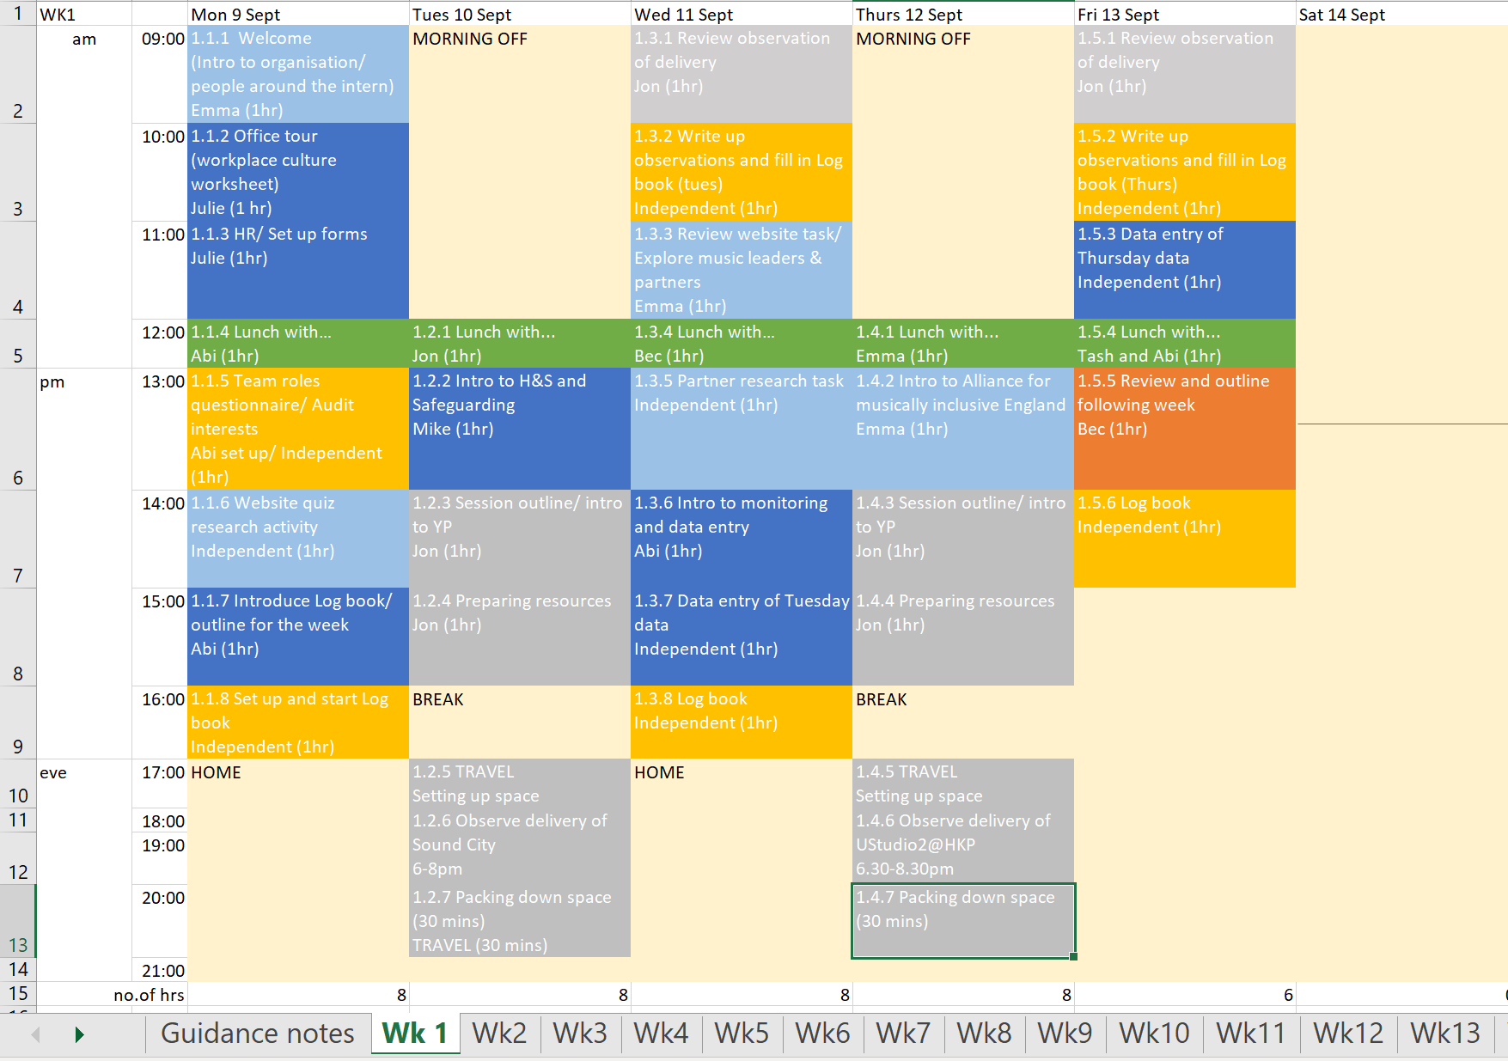
TIMETABLE
Activity numbers
Colour coded
Working hours
Additional tasks and activities
Record and measure
Notes:
The timetable is a guide only
Activity number references mapped to session library
Colour coded for easy reference and to ensure coverage of tasks
Working hours have been calculated to average of 37 hours a week
Lunch is included in the hours when the intern is not able to be anywhere else
Not all activities on the timetable will take the full hour given
Administration tasks and personal activities
Intern to record how long they take on each task

Slide 13
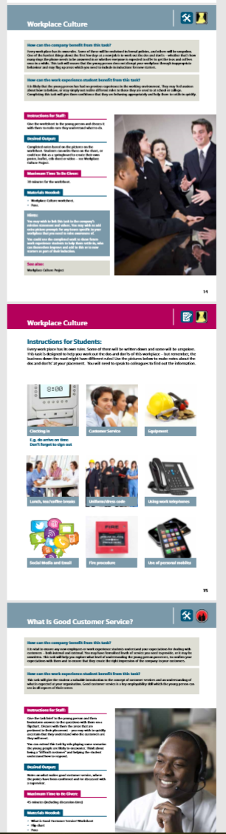
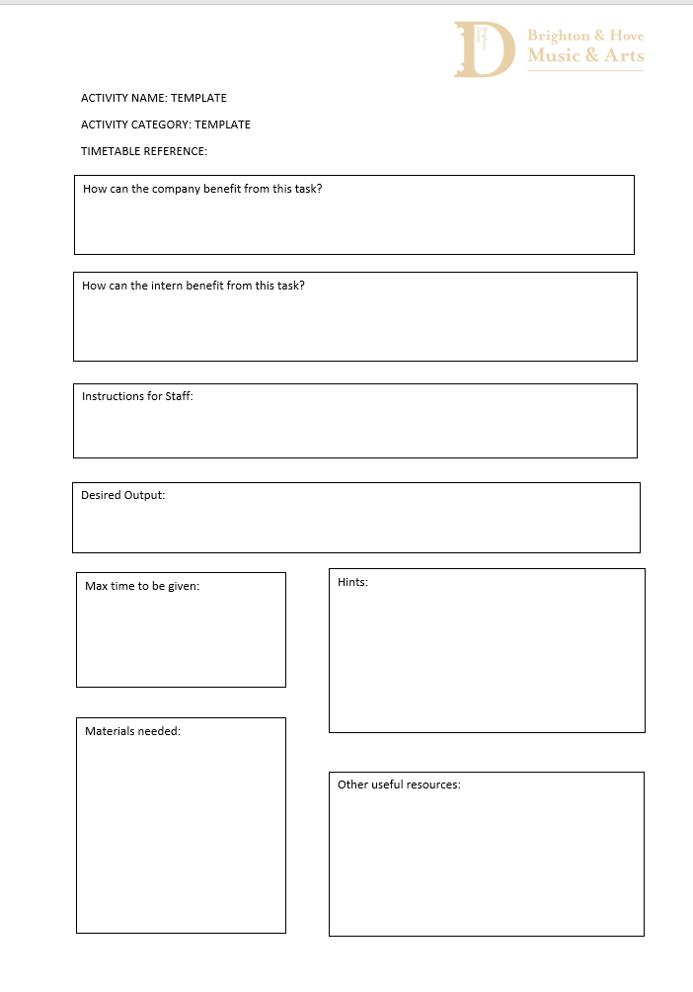
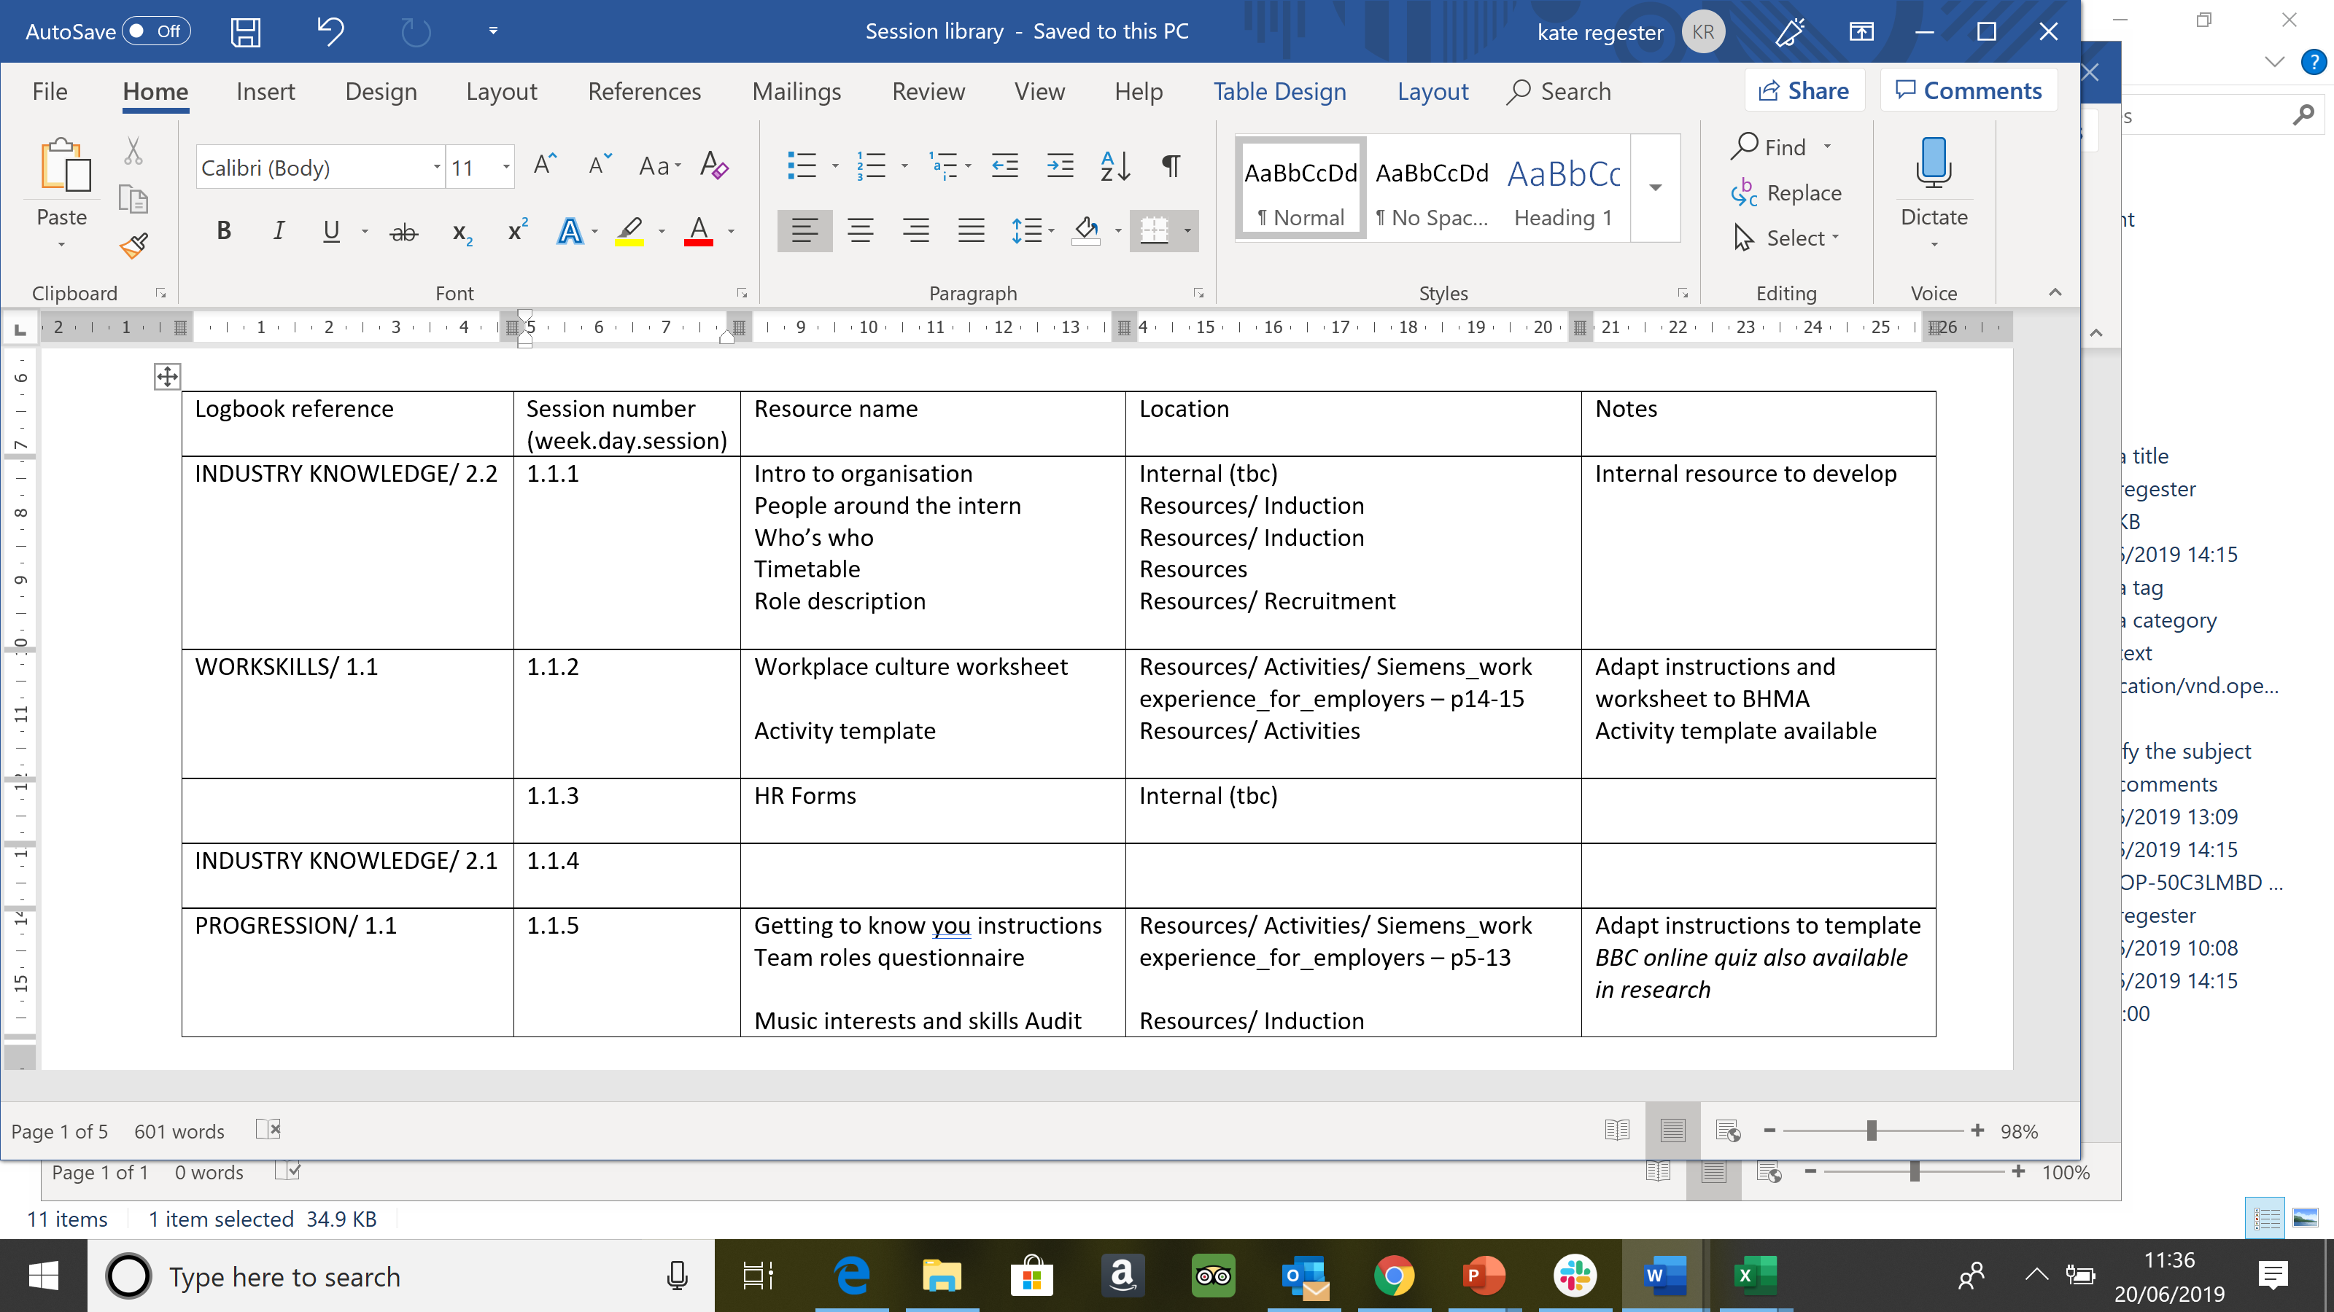
RESOURCE LIBRARY
Session Library
  Logbook reference
  Resources week 1-4
Additional resources in RESEARCH folder
Activity template
Notes:
Session Library outlines the resources available for the activities listed on the timetable weeks 1-4
Cross-referencing these with the logbook reference
If no resource - Logbook will list activity suggestion
Additional resources in the RESEARCH folder
Logbook references refer to the tab in which they are listed, the vertical axis number then the horizontal axis number. Where no horizontal axis number occurs, this is because the level of activity suggested is dependent on progress made by the intern.
The session number is refers to the week, day and session within the day – numbers are also shown on the timetable.

Slide 14
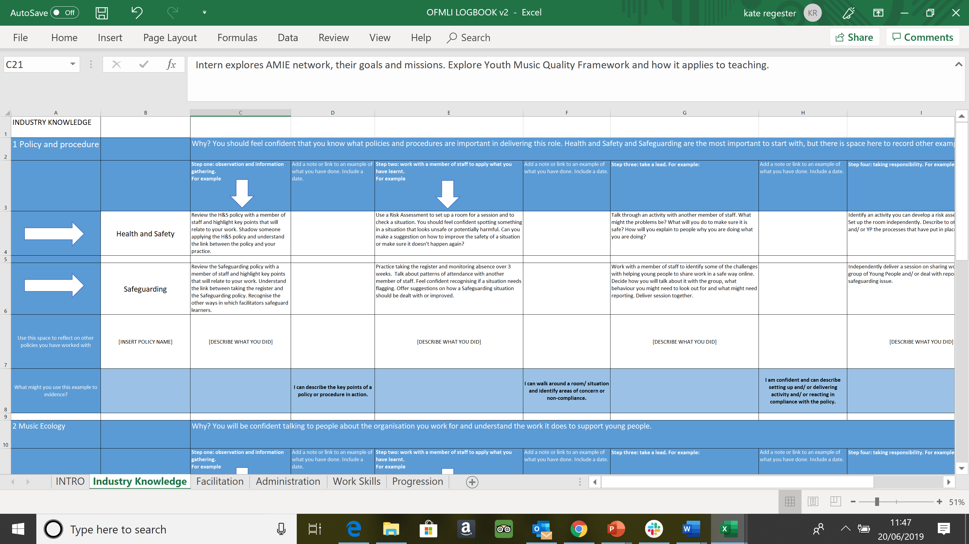
LOG BOOK / SKILLS GRID
Expectations
Record
Activities
Employability
Notes:
- outline what is expected and what you are aiming for,
- support you to progress at your own rate; you will be active in deciding when you are confident and ready to move on,
- help you maintain a record of what you have done and achieved.
This internship programme is designed to be flexible – whatever your starting point. The activities listed are just examples, but for every skillset you will follow these stages:
1. Observing and information gathering.
2. Working with a member of staff to apply what you have learnt.
3. Taking the lead, but with supervision.
4. Taking responsibility and working independently.
You are not expected to be taking responsibility and working independently for every skillset by the end of your internship. You will be supported to progress at your own rate, alongside the needs of the project. The logbook is to support you with this. Make notes and collect examples in the way that suits you.
A range of staff will support you in different elements of the internship, as illustrated in the diagram.
You have time most days allocated to update your logbook and save pictures or worksheets in folders on the drive. You will review your logbook during supervision sessions with your buddy and manager to recognise progress, assign new tasks and adapt your schedule to your needs and interests.
When you apply for your next role these examples will demonstrate your aptitude. Noting your progress as you go along will make that process easier. Included in the logbook is an example sentence of how you can use the experience you have collected to demonstrate a skill in a recruitment scenario.

Slide 15
TIMELINE
July 2019
advertise
Aug. 2019
recruit
Sep. 2019
intern starts
Nov. 2019
review and amend
Dec. 2019
placement 1 ends
Jan. 2020
onwards – 5 further internships over next 2 years
As part of The Alliance for a Musically Inclusive England, Our Future Music is delivered by the Southern Music Hub Alliance, and supported by Youth Music.
The Southern Music Hub Alliance is: Create Music • Kent Music • Surrey Music Hub • West Sussex Music

